Slide 1
Project Presentation on Exam Portal Presented by : Miss. ManAsi Gaykwad Miss. Mayuri Vaishnav Under the Guidance of Trainer : Priti Yadav Anudip Foundation

Slide 2
INDEX
Introduction
Objective
Proposed work : Tools/Platform and Languages to be used.
Advantage Of Project
ER Diagram
Conclusion
Future scope
References

Slide 3
INTRODUCTION:-
In the proposed system, the administrator can insert, delete and modify the patient records as per the requirements. The laboratory reports and billing details can be easily maintained in this system. This project will help to smoother the process of the hospital activities.

Slide 4
OBJECTIVE OF THE PROJECT :-
This main objective of the system is to computerize the maintenance of the patient details and billing section in the hospital. It also includes the details about the laboratory checkups.

Slide 5
SOFTWARE/HARDWARE REQUIREMENT SPECIFICATION
• Operating System : Windows 7/8/10/11
• Application : HTML & CSS & Angular Framework & Hibernate JPA
Spring Boot .
• Database : MYSQL SERVER & Hibernate
• Software : Eclipse / Spring Tool Suit / MySQL Workbench
Minimum hardware Requirement
386,486 processors with supportable motherboard.
64 MB RAM.
Colour monitor for better display
Keyboard
Mouse

Slide 6
ADVANTAGE OF PROJECT:-
Minimize handwritten work from admission to discharge & final billing.
It helps you to minimize your repeated works and take care of the complete functionality of your hospital.
It is a huge time saver and facilitates proper communication among the management, staff, and the patient parties.
Changes are always difficult for any human being. HMS will help you a lot for easy changes from manual to computerized one.

Slide 7
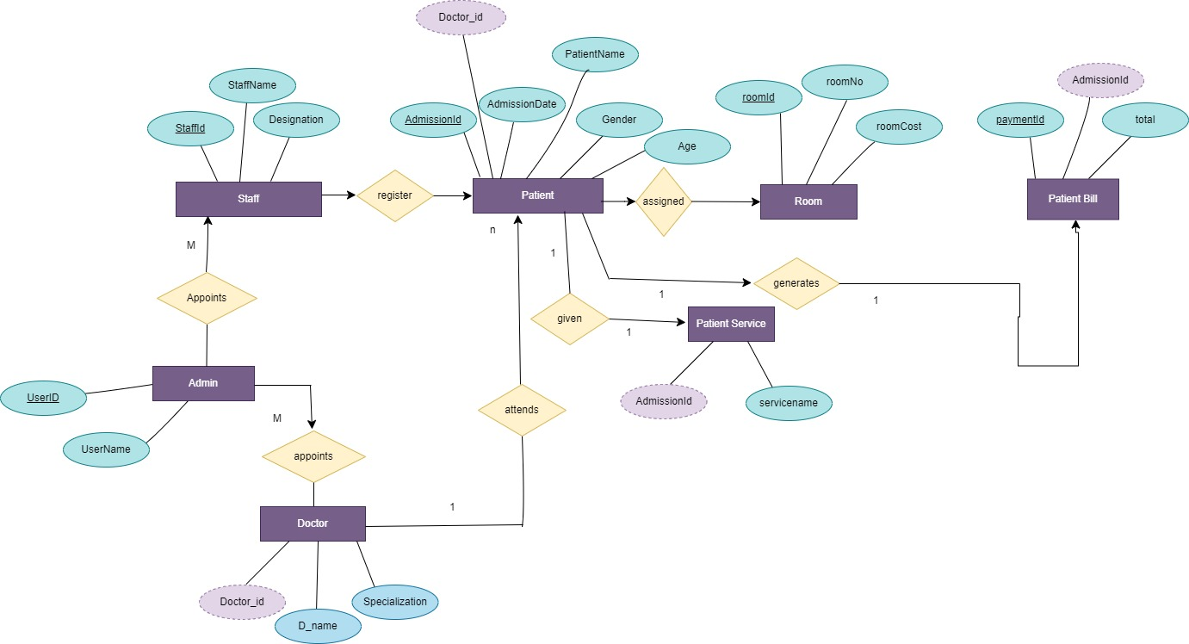
ER Diagram

Slide 8
CONCLUSION :-
Working on the project was an excellent experience. It helped us to understand the importance of planning, designing and implementation so far we have learnt in our theory books. It helped us unleashing our creativity while working in a team. It also realized the importance of team working, communication as a part of this project.
The project was successfully completed after a lot of efforts and work hours. This project underwent number of compiling, debugging, removing errors, making it bug free, adding more facilities in Hospital Management System and interactivity making it more reliable and useful.

Slide 9
SCOPE :-
HMS is windows based Hospital management software. Provides password facility for different users to ensure high level of security.
Single database management system.
It is completely user friendly hospital management software.
It automates the patient billing process completely.

